Slide 1
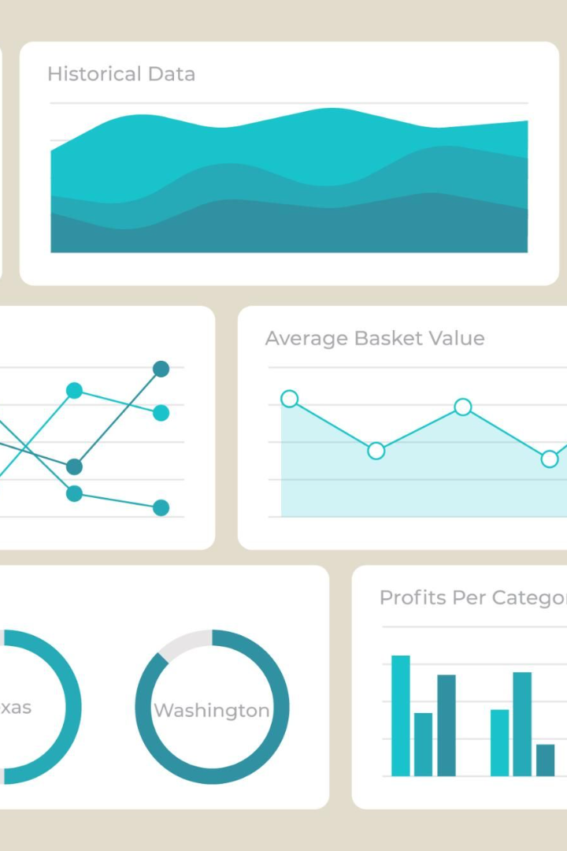

Creating an Engaging Dashboard with Tableau
Join us as we explore the art of creating a beautiful dashboard with Tableau, and learn how you can present complex data in a visually engaging and accessible way.
by Karri Dharma Teja

Slide 2
Get a Quick Overview with the Data Summary Tab
Total Sales
Top Products
Geographic Sales Map
Find out the total sales revenue, profit, and other key metrics.
Discover the top-performing products in terms of sales, units, and profit margin.
Visualize where your sales are coming from geographically and identify key markets.
Sales Funnel Analysis
Understand your sales funnel and see where you can improve your conversion rates.

Slide 3
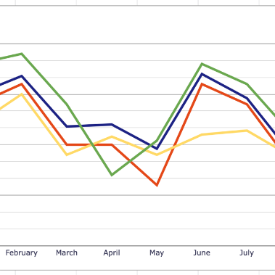
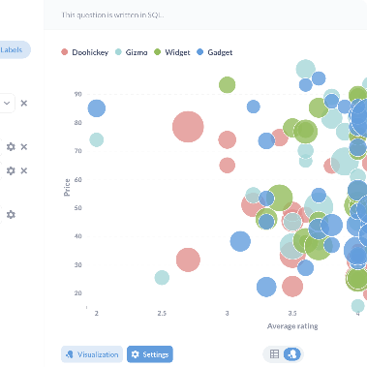
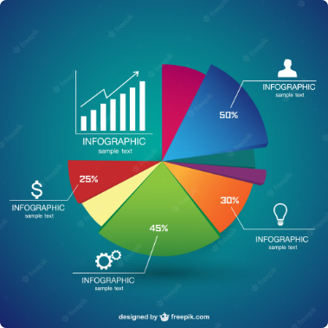
Discover Trends and Patterns with the Trends Tab
Sales Trends
Product Sales
Sales by Channel
Analyze sales trends by month, quarter, and year to identify seasonality and growth opportunities.
Visualize sales by product category and location, and identify cross-selling opportunities.
Understand the distribution of sales across different channels, and optimize your marketing mix.

Slide 4
Segment Your Customers for Better Insights
Demographic Segmentation
Analyze your customers' demographics, such as age, gender, income, and location, and uncover patterns and opportunities.
1
2
3
Behavioral Segmentation
Psychographic Segmentation
Understand your customers' buying behavior and identify key groups based on purchase history and preferences.
Segment your customers based on their attitudes, values, and lifestyle, and personalize your marketing and messaging.

Slide 5

Measure the Value with ROI and CLV
1
ROI Analysis
2
Customer Lifetime Value
Calculate the return on investment for your marketing campaigns and initiatives, and optimize your budget.
Estimate the long-term value of your customers and prioritize customer retention strategies.
3
Cost-Benefit Analysis
Evaluate the costs and benefits of new initiatives and projects, and make informed decisions.

Slide 6
Create an Effective Marketing Strategy
Target Audience
Identify and understand your target audience, and develop a messaging and positioning strategy that resonates.
Marketing Mix
Design a holistic marketing mix that includes product, price, promotion and distribution, and optimize your marketing budget allocation.
Brand Positioning
Differentiate your brand from the competition and build a strong and consistent brand identity across all touchpoints.

Slide 7

Accelerate Your Growth with a Growth Strategy
Expansion Strategy
Identify new markets, product categories and channels for growth, and develop a strategy to enter them.
Innovation Strategy
Explore new product and service offerings, and launch new products and services that appeal to your target market.
Partnership Strategy
Form strategic partnerships with other businesses, vendors, and organizations to expand your reach and accelerate your growth.

Slide 8
Conclusions and Recommendations
Data-Driven Marketing
Engaging Data Visualization
Use data and insights to drive your marketing strategy, and measure your results to improve your performance over time.
Present data in a visual and engaging way that is easy to understand, and use clear and concise messaging to communicate your key points.
Actionable Insights
Data Storytelling
Effective Decision-Making
Effective Design
Continuous Improvement
User-Centered Experience

